Slide 1
Financial Accounting (FI)
Curriculum: Introduction to S/4HANA using Global Bike

Slide 2
3.2 (May 2018)
S/4HANA 1709 Fiori 2.0
Global Bike
No Prerequisites needed

Slide 3
Bret Wagner
Stefan Weidner
Babett Ruß
Beginner

Slide 4
You are able to
define the central organizational structures of the FI module.
summarize the master data which is most important for the FI module.
explain a standard financial accounting process.
outline the basic functionalities of FI reporting.
recognize some of integration points to other SAP modules.

Slide 5
Agenda
FI Organizational Structure
FI Master Data
FI Processes
FI Reporting
Innovations in S/4HANA

Slide 6
Agenda
FI Organizational Structure
FI Master Data
FI Processes
FI Reporting
Innovations in S/4HANA

Slide 7
Goal of Financial Accounting (FI)
Financial Accounting is designed to collect the transactional data that provides a foundation for preparing the standard portfolio of reports.
In general, these reports are primarily, but not exclusively, directed at external parties.
Standard reports include:
Balance Sheet
Income Statement
Statement of Cash Flows

Slide 8
Target Audience
Internal
Executives
Senior Management
Administrative Staff
Employees
External
Legal Authorities
Banks
Auditors
Shareholders
Insurance
Taxing Authorities
Media
Financial Analysts

Slide 9
FI Organizational Structure
Client
An independent environment in the system
Company Code
Represents an independent legal accounting unit
Balanced set of books, as required by law, are prepared at this level.
A client may have more than one company code
United States
Germany
United Kingdom
Australia
…
Assets
Liabilities &
Owners Equity

Slide 10
FI Organizational Structure
Chart of Accounts
A classification scheme consisting of a group of general ledger (G/L) accounts
Provides a framework for the recording of values to ensure an orderly rendering of accounting data
The G/L accounts it contains are used by one or more company codes.
Credit Control Area
An organizational entity which grants and monitors a credit limit for customers.
It can include one or more company codes
Business Area
An organizational unit that represents a separate area of operations or responsibilities within an organization and to which value changes recorded in Financial Accounting can be allocated
Financial statements can be created for business areas, and these statements can be used for various internal reporting purposes.

Slide 11
Global Bike Structure for Financial Accounting
Global Bike
Client
Global Bike Inc.
Global Bike Germany GmbH
Company
Code
Global Bike
Chart of Accounts
Chart of
Accounts
Bikes
Business Area
Global Credit Control
Credit Control
Area

Slide 12
Global Bike Enterprise Structure in SAP ERP (Accounting)
Business Area – Bikes BI00
CC CA00
CC GB00
CC AU00
CC JP00
CC US00
CC DE00
Company
Code
Chart of Accounts (global) GL00
Credit Control Area (global) GL00
CA North Am. NA00
CA Europe EU00
CA Asia AS00
Controlling Area
(see Controlling unit)
Operating Concern (global) GL00
Operating Concern
(see Controlling unit)
Client Global Bike
Notes:
Organizational units displayed in grey are not yet implemented, but are already planned in Global Bike.

Slide 13
Agenda
FI Organizational Structure
FI Master Data
FI Processes
FI Reporting
Innovations in S/4HANA

Slide 14
FI Master Data
General Ledger (G/L) Accounts
The unique combination of Company Code and Chart of Account creates a data storage area called a General Ledger.
The General Ledger contains a listing of the transactions effecting each account in the Chart of Accounts and the respective account balance.
It is utilized in the preparation of financial accounting statements.

Slide 15
FI Master Data
Customer and Vendor Master Data
Customer and vendor account balances are maintained in FI through fully integrated accounts receivable and accounts payable sub-ledgers.
Financial postings for customers and vendors are made directly to their respective individual accounts and accompanied by a concurrent automatic posting to the General Ledger.

Slide 16
Customer Accounts
Accounts Receivable Sub-Ledger (FI-AR)
Information with respect to customers who purchase the enterprise’s goods and services such as sales and payments made
Substantive and important integration between Sales and Distribution (SD) and Financial Accounting (FI)
Billings in SD generate FI journal entries for sales activity
Customer 189
Customer 142
Accounts Receivable
(General Ledger)
100
300
950
Customer 135
Customer 123
400
150

Slide 17
Vendor Accounts
Accounts Payable Subledger (FI-AP)
Information with respect to Vendors from whom the enterprise purchases goods and services such as purchases and payments made
Substantive and important integration between Materials Management (MM) and Financial Accounting (FI)
Purchase and goods receipt activities in MM generate FI journal entries
Vendor 100234
Vendor 100435
Accounts Payable
(General Ledger)
200
250
850
Vendor 100621
Vendor 100846
100
300

Slide 18
Agenda
FI Organizational Structure
FI Master Data
FI Processes
FI Reporting
Innovations in S/4HANA

Slide 19
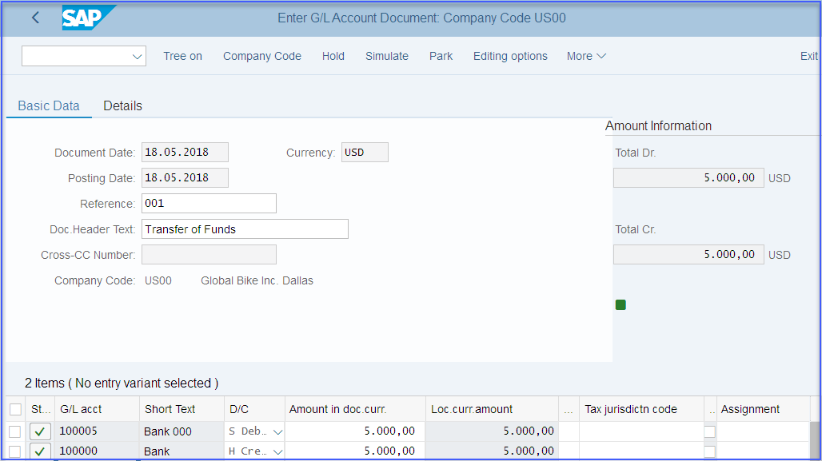
FI Processes
Posting a G/L Entry

Slide 20
Agenda
FI Organizational Structure
FI Master Data
FI Processes
FI Reporting
Innovations in S/4HANA

Slide 21
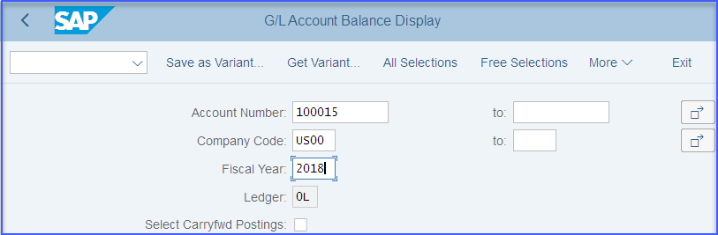
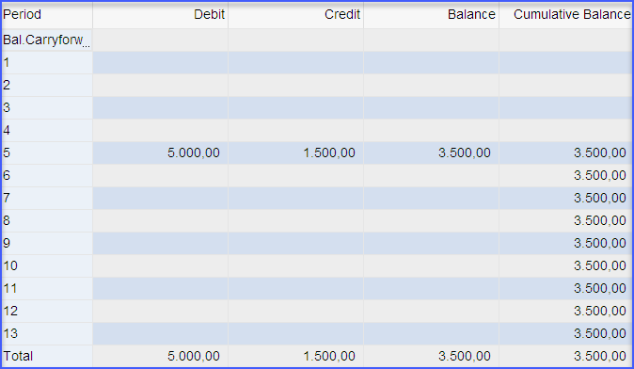
FI Reporting
G/L Account Summary

Slide 22
FI Reporting
Balance Sheet
Presentation of an organization’s Assets, Liabilities, and Equity at a point in time
Assets: What the company owns
Liabilities: What the company owes
Equity: The difference between Assets and Liabilities
Assets = Liabilities + Equity

Slide 23
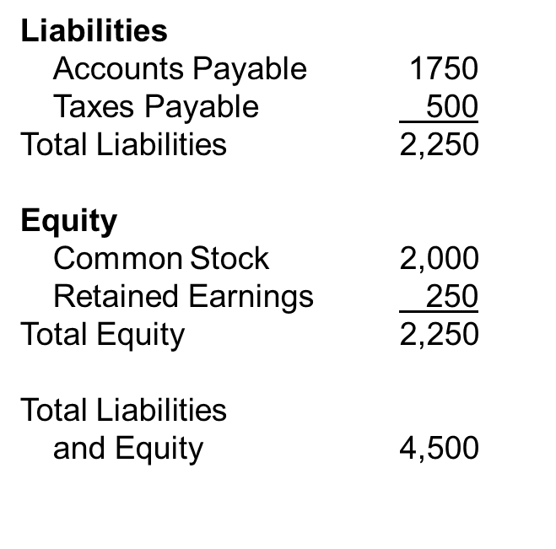
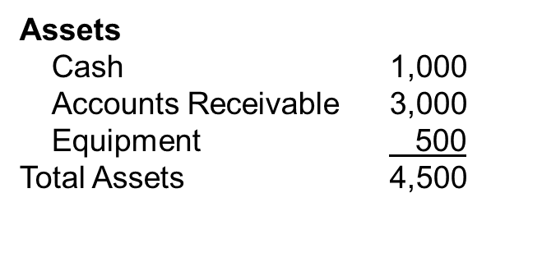
FI Reporting
Balance Sheet Example

Slide 24
FI Reporting
Income Statement
Presentation of an organization’s revenues and expenses for a given period of time (e.g. monthly, quarterly, or yearly)
Revenues, in a simple sense, are inflows of cash as a result of selling activities or the disposal of company assets.
Expenses, in a simple sense, are outflows of cash or the creation of liabilities to support company operations.
Revenues - Expenses = Net Income

Slide 25
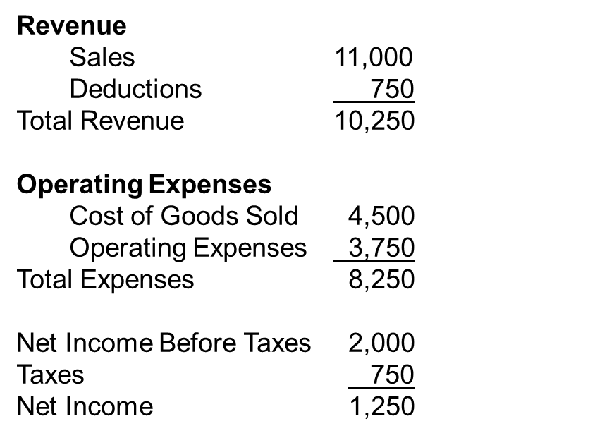
FI Reporting
Income Statement Example

Slide 26
FI Reporting
Statement of Cash Flows
Considers the associated changes, both inflows and outflows, that have occurred in cash – arguably the most important of all assets – over a given period of time (e.g. monthly, quarterly, or annually)

Slide 27
Accountants and Audit Trails
Audit trails allow an auditor to begin with an account balance on a financial statement and trace through the accounting records to the transactions that support the account balance.
Audit trails enable an auditor to trace individual transactions to the effected account balance(s) on a financial statement.

Slide 28
SAP Document Principle
Each business transaction impacting FI writes data to the SAP database creating a uniquely numbered electronic document.
The document number can be used to recall the transaction at a later date.
It contains, for example, such critical and necessary information as:
Responsible person
Date and time of the transaction
Commercial content
Once written to the SAP database, a financial document (one impacting the financial position of the company) can not be deleted from the database.
It can be changed to some degree.
The SAP document principle provides a solid and important framework for a strong internal control system – a requirement of law for companies that operate in most countries in the world.

Slide 29
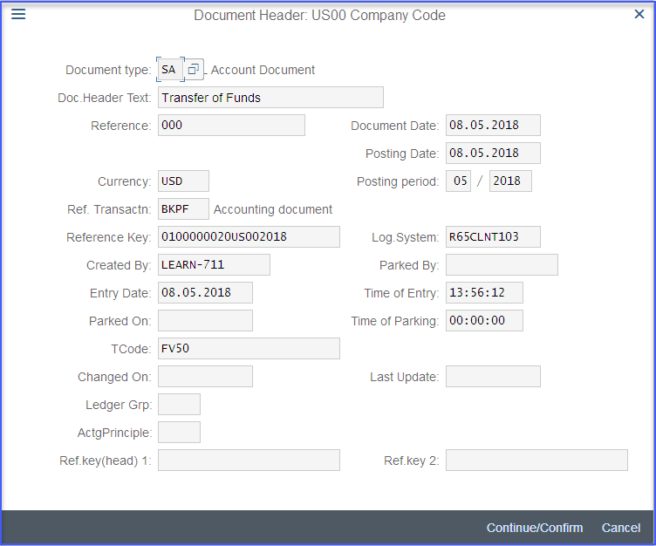
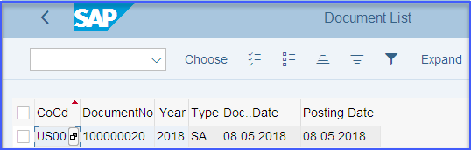
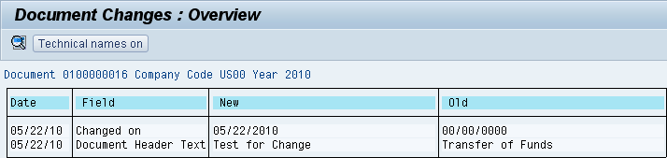
SAP Document Principle

Slide 30
SAP FI Module
Fully integrated with other SAP modules including, but not limited to:
Sales and Distribution (SD)
Materials Management (MM)
Production Planning and Execution (PP)
Managerial Accounting (CO)

Slide 31
Agenda
FI Organizational Structure
FI Master Data
FI Processes
FI Reporting
Innovations in S/4HANA

Slide 32
Innovations in S/4HANA
The General Ledger is the Single Point of Truth. All transactions are stored in the Universal Journal table. The table also stores transactions for Controlling thereby removed many of the reconciliation activities in ERP.
Finance incorporates a re-designed General Ledger and and new asset accounting functionalities.
Using the real time SAP HANA database means that reporting from many different finance areas is unified into a single repository.

Slide 33
Innovations in S/4HANA General Ledger
General Ledger in S/4HANA is based in the Universal Journal
Line items are stored in the new database table ACDOCA -> optimized to SAP HANA
no need for CO real-time integration for transfer of secondary CO postings to New GL or the Reconciliation Ledger of Classic GL
CO internal postings are now visible in General Ledger as well
The new journal entry consists of a header (table BKPF) and the respective items (table ACDOCA).
The ACDOCA table contains all fields needed for G/L, CO, AA, ML, PA, providing one single source of truth for all these modules. For CO, the universal journal also contains all cost elements, including secondary cost elements, which are also in SAP S/4HANA G/L accounts.

Slide 34
Innovations in S/4HANA General Ledger
General Ledger Accounting
Profitability Analysis
Ledger
Company
Account1
Account2
Account3…
Profit Center
Operating Concern
Segment
Universal Journal (New Table in S/4 HANA sFIN: ACDOCA)
Ledger
Company
Cost Elements
Profit Center
Account1
Account2
……
Asset
Material
Controlling
Asset Accounting
Material Ledger
Controlling Area
Cost Elements
Account1
Account2…
Company
Assets
Company
Materials
Various accounting applications merge in the new structure of Universal Journal (ACDOCA)
The new comprehensive data table ACDOCA contains all of the line item documents from FI, FI-AA and CO

Slide 35
Innovations in S/4HANA Data Model is made very simple
All the Aggregate and Index tables are removed and are calculated on the fly
Before
S/4 HANA
BKPF
BSEG
BSIS
BSIK
BSET
SAP ERP
Financials with Aggregates and Indices
LFC1
GLTO
COBK
COEP
COSP
After
S/4 HANA
S/4 HANA Financials
BKPF
BSEG

Slide 36
Innovations in S/4HANA Financial Reporting and Analytics Simplified
Before
Traditional
Financial
Reporting
Financial Reporting
Management Reporting
FI
CO
CO-PA
SAP ERP
Financials
OR
OR
After
Unified Reporting
Financial Reporting
Management Reporting
FI
CO
CO-PA
SAP S/4 HANA Financials
+/AND
+/AND
Key Figures
Measures
Dimensions
Comprehensive Reporting Including CO and CO-PA detail
Reporting is not limited by application boundaries
Run one report (e.g. P&L) and drill-down to any dimension available in the financial documents

Slide 37
Innovations in S/4HANA Currencies in Universal Journal
Situation in ECC | Situation in S/4H
In the Business Suite (ECC) there used to be up to 3 parallel currencies in FI (table T001A / tx OB22) and 2 parallel currencies in CO (TKA01 / tx OKKP): CO area currency and object currency | With the universal journal and the common line item table ACDOCA for FI and CO, there is also a central currency configuration for the universal journal. As the currency configuration depends on the universal journal ledgers, there is a combined view cluster for ledgers and currencies, tx FINSC_LEDGER
The currencies of non leading ledgers in New GL (T882G) were a subset of the currencies in the leading ledger (T001A) | Table BSEG is not extended and still contains only 3 parallel currencies
One of the CO currencies needed to be the local currency (CT 10), but it was not necessary that the other currency in CO was also configured in FI | SAP´s goal is to implement full process integration of all currencies fields in all processes in accounting
 | all journal entry items are converted in the accounting interface for all configured currencies, regardless of the source where the business transaction originates from

